Slide 1

Gender Responsive Budgeting (GRB)
Optimizing Growth and Resilience through Evidence-based Policies and Budgeting:
Rwanda Ministry of Finance and Economic Planning
May 2026

Slide 2
Content
Background
Gender equality goal and objectives
Gender Budget Statement (Sample)
Planning, reporting, monitoring and evaluation
Challenges and next steps

Slide 3
Background
  First championed by the Ministry of Gender and Family Promotion (MIGEPROF) as a pilot project.
  Shifted to MINECOFIN under the National Budget Department
  First GBS preparation guidelines issued by MINECOFIN in 2009/2010.
  First piloted in 4 Sectors and 4 Districts (Education, Infrastructure, Health and Agriculture).
  Rolled out to all Budget Agencies (MDAs) since 2011/12 .
  Government leaders retreat recommended the institutionalization of Gender Responsive Budgeting (GRB) and gazeated in the 2013 Organic budget law.

Slide 4
Elements of Gender Responsive Budgeting (GRB)
GBS (reports GRB) is a specific accountability tool to all budget agencies and districts which is meat to mainstream gender in the national PFM.
Gender mainstreaming in all sector of budget and economic sectors
  Gender equality and equity
  Gender Based Violence (GBV)
  Gender inclusion
  Gender promotion
  Gender advocacy

Slide 5
Gender equality goals
How they are prioritized in the budget process?
To improve gender equality and equity in various sectors while increasing Women’s access to economic resources and opportunities;
  Ensuring that Women and Men are free from any form of gender-based violence. (Revised National Gender Policy 2021).
Key factors of GRB
Political will
Strong institutional collaboration and accountability
Coordination by Ministry of finance, Ministry of Gender and GMO
Strong laws by parliament

Slide 6
Rwanda’s Gender Equality Objectives : How they are prioritized
Strengthening gender mainstreaming and accountability across national sector policies, planning frameworks and strategies in public and private sector.
Ensure equal access and control of productive resources and economic opportunities for women and men, boys and girls.
Improve gender equality in education, health and social protection.
Identify, map and address persistent cultural norms, gender stereotypes, and imbalances affecting the principles of gender equality and equity between women and men and girls and boys.

Slide 7
GBS and Budget Frame Work Paper (BFP)
GBS is integrated in financial laws governing public fund management
PFM Law, N° 002/2022.OL of 12/12/2022, Chapter III: Article 34; Preparation and presentation of the budget framework paper.
GBS is annexed to Budget Framework Paper (BFP) which should be approved by the Cabinet before being presentation to both Chambers of Parliament.

Slide 8
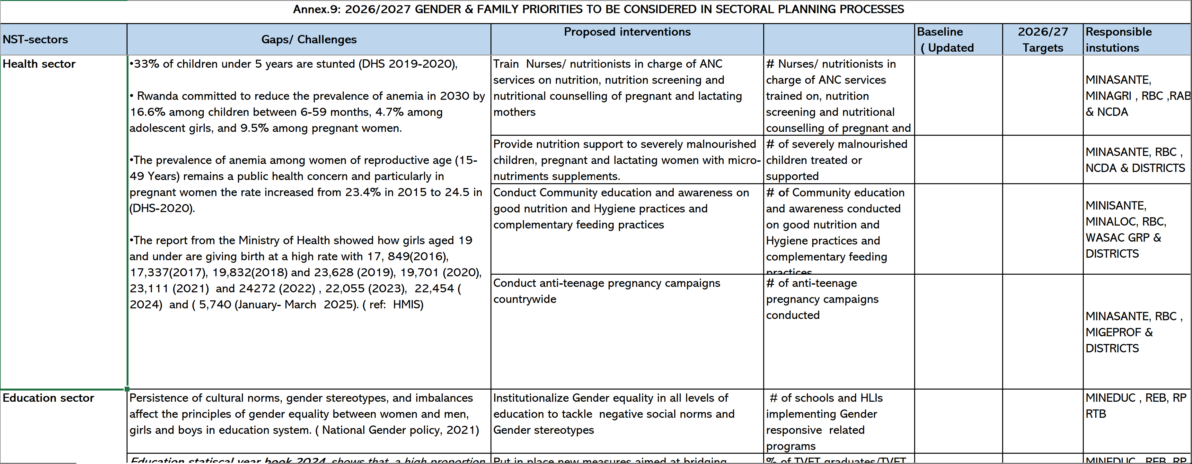
Process: Planning phase
Planning and Budget Call Circular I: What are the gender instructions?
Annex on Gender and Family Promotion: contains gender priorities, proposed interventions and indicators by sector for national wide planning

Slide 9
Process: Budgeting phase
The Budget Call Circular II
Detailed annex on gender mainstreaming guidelines. This contains the GBS planning and budgeting templates, criteria for selecting sub-programs, steps for gender analysis etc….
Analysis expected here from the MDAs is;
Identify a sub-program
Identify the gender gap-backed by current/official data.
What are the root causes for the identified gender gap
What are the planned interventions.
Gender distribution of employment:
Analysis is done in reference to the Rwandan constitution that provides for 30% quota of women in all decision-making organs.
What are the gender issues affecting women to participate in the labour force from the senior positions to lower levels e.g (Permanent Secretaries to support staff e.g Secretaries),

Slide 10
GBS Sample: Advancing gender equality goals through GBS
2025/26 Gender Budget Statement (GBS) - Ministry of Infrastructure
Agency: Energy Development Corporation Limited/EDCL
Gender Situational Analysis (Clearly state the existing gender problem in the selected S/P backed by sex disaggregated data where applicable). | Output | Planned Activities to reduce the gender gap | Indicator (dis aggregated by sex where applicable) | Target (dis aggregated by sex where applicable) | Approved Budget FY 2025/2026 [FRW]
NST 2 Priority Area: Scale up electrification to achieve universal access.
Program 1: Fuel and Energy
Subprogram 1: Electricity Access
Increasing access to electricity is a universal goal which is key to GoR. While many initiatives on access to electricity have been implemented, a number of HHs especially female headed HHs in rural areas remain without electricity. In this regard, the GoR has prioritized solar energy as a solution for lighting substitute especially in remote areas. Currently over 880,000 HHs have benefited access to electricity with the solar home systems while more than 2,000,000 are connected to the grid. The majority of HHs that are located in remote areas are characterized by poverty where a big number are FHHs. Among the many factors that contributed to poverty is lack of access to electricity which has an impact on the social economic welfare of the HHs members i.e job creation, community security, children's education etc. The access to electricity will enable female HHs from remote areas to improve their social well-being, earn productive time for their development, facilitate children to improve their performance at school etc. | Access to electricity increased. | Connecting 250,000 new households to electricity | 250,000 new households (100,000FHHs and 150,000MHHs) connected to the grid | 250,000 households (100,000 Female Headed Household and 150,000 Male Headed Household connected to the grid) | 128,017,207,436
 |  | Connecting 50,000 new Male and Female households to off grid | 50000 households i.e (20,000FHH and 30,000MHH) connected to off-grid electricity. | 50000 households (20,000 Female Headed Household and 30,000 Male Headed Household connected to off-grid electricity).

Slide 11
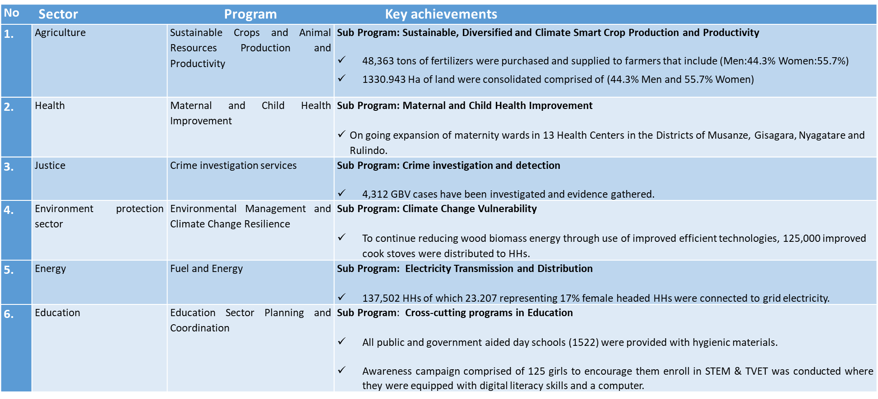
Sample of Gender equality interventions achieved as part of the GBS 2024/25

Slide 12
Closing gender gaps through the GBS: Ministry of Infrastructure annual report 2024
In Fuel and Energy, 166,264 HHs received clean cookstoves (41.6% female-headed).
110,874 HHs gained off-grid solar systems (27.4% female-headed),
Transport infrastructures to increase women workforce participation.
90% of staff at the construction site free from GBV.
By doing that, the intension is to;
Improving health services for women and girls
Reducing firewood collection time
Enabling small business opportunities for women

Slide 13
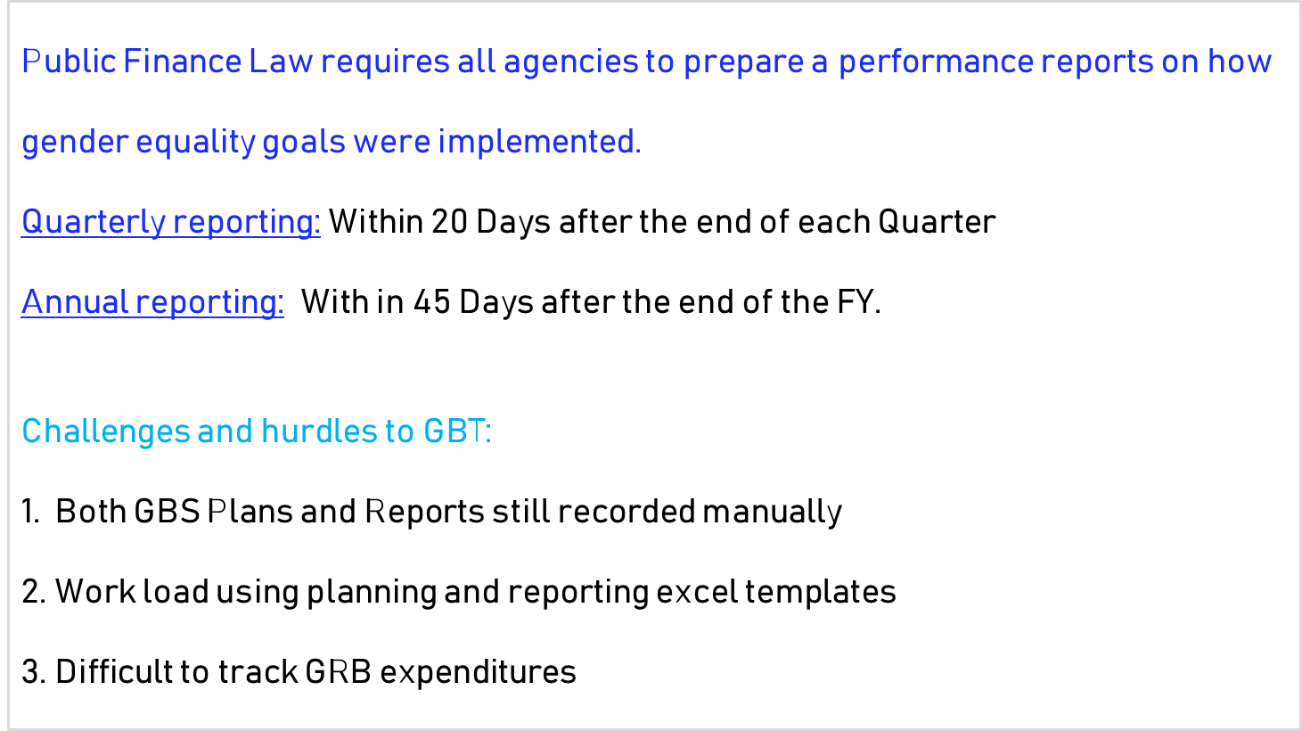
Reporting: Performance/implementation of program priorities

Slide 14
Monitoring and Evaluation: Gender Monitoring Office (GMO)
Gender Monitoring Office has the following key responsibilities:
Monitoring the respect and compliance of gender related commitments across public, private, non-governmental and religious institutions;
Monitoring the respect of ratified regional and international gender related commitments;
Monitoring the quality of services offered to Gender Based Violence victims and effectiveness of Gender Based Violence prevention and response mechanisms;
Carrying out research based on statistics on specific issues in the framework of mainstreaming and respecting gender principles;

Slide 15
2. A roadmap to Gender Budget Tagging (GBT)
Where are we? from gender mainstreaming to responsive and budget tagging
Automation of the recording of plans/priorities and reporting process
  In Integrated Financial Management System (IFMS)
Worked with IFMIS to develop user guide requirements manual and automation guidelines
Aiming to begin pilot automation in 2026/27 FY
Trainings for planners on the GBS user requirement manual and the GBS automation planned in September 2026.
Gender budget tagging: each intervention will be earmarked to a corresponding budget.

Slide 16
Murakoze!!!

